Slide 1
Multiplicative relationships and direct proportion
Task A: Direct proportion
1) Which of the following show a directly proportional relationship between A and B?
a)
A | B
3 | 12
6 | 24
8 | 32
10 | 40
b)
A | B
4 | 7
6 | 11
8 | 15
10 | 19
c)
A | B
5 | 35
15 | 105
20 | 140
30 | 210
d)
A | B
4 | 2
7 | 3.5
9 | 4.5
14 | 7
e)
A | B
3 | 13
4 | 16
5 | 19
8 | 28
f)
A | B
100 | 25
80 | 20
75 | 18.75
40 | 10
The tables which show a directly proportional relationship are a, c, d, f.
2) Below are some variables which are directly proportional to each other.
a) Jun is painting his neighbour’s fence. He paints one fence every 40 minutes.
i) A double number line and mark on at least 3 equivalents
ii) A ratio table
1
2
5
6
Fence
Time
40
80
200
240
Fence | Time
1 | 40
6 | 240

Slide 2
Multiplicative relationships and direct proportion
b) Andeep is making necklaces for the school fete. He makes 2 necklaces every 7 minutes.
i) A double number line and mark on at least 3 equivalents
ii) A ratio table
2
4
10
12
Necklaces
Time
7
14
35
42
Necklaces | Time
2 | 7
10 | 35
c) 5 miles is equivalent to 8 km.
i) A double number line and mark on at least 3 equivalents
ii) A ratio table
5
10
25
30
Miles
Kilometres
8
16
40
48
Miles | Kilometres
5 | 8
10 | 16
d) A box of tiles covering 0.75 m², costs £15
i) A double number line and mark on at least 3 equivalents
ii) A ratio table
0.75
1.5
5
6
Area
Cost
15
30
100
120
Area | Cost (£)
0.75 | 15
10 | 200
e) Sofia’s dog eats 3 tins of food every 4 days.
i) A double number line and mark on at least 3 equivalents
ii) A ratio table
3
6
15
18
Tins
Day
4
8
20
24
Tins | Day
3 | 4
15 | 20

Slide 3
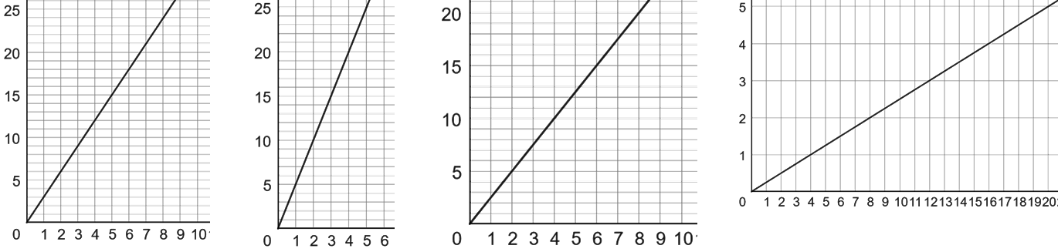
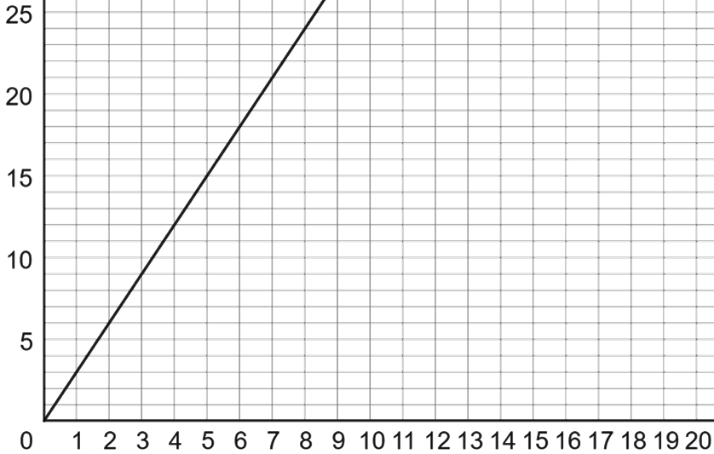
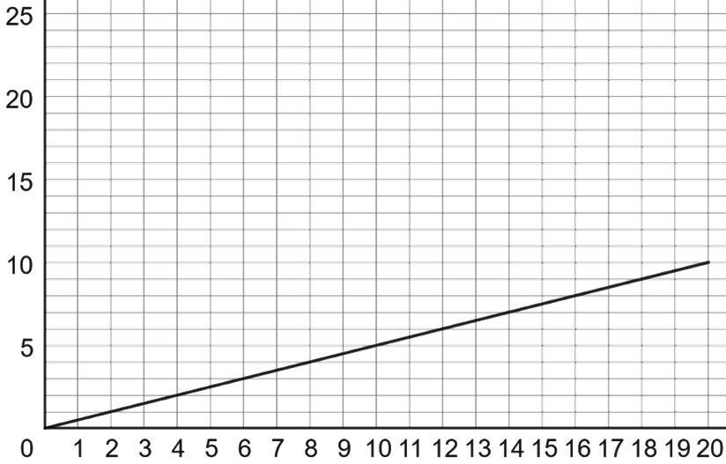
Multiplicative relationships and direct proportion
Task B: Graphing proportional relationships
1) Match each table to the correct graph and fill in the missing values:
A
B
C
D
2 | 5
7 | 17.5
3 | 7.5
8 | 20
2 | 6
5 | 15
3 | 9
4 | 12
4 | 1
6 | 1.5
8 | 2
16 | 4
3 | 15
7 | 35
2 | 10
5 | 25
C
A
D
B
2) The following all have a directly proportional relationship. Plot a graph of each.
a)
b)
2 | 6
3 | 9
4 | 12
6 | 18
4 | 2
8 | 4
12 | 6
16 | 8

Slide 4
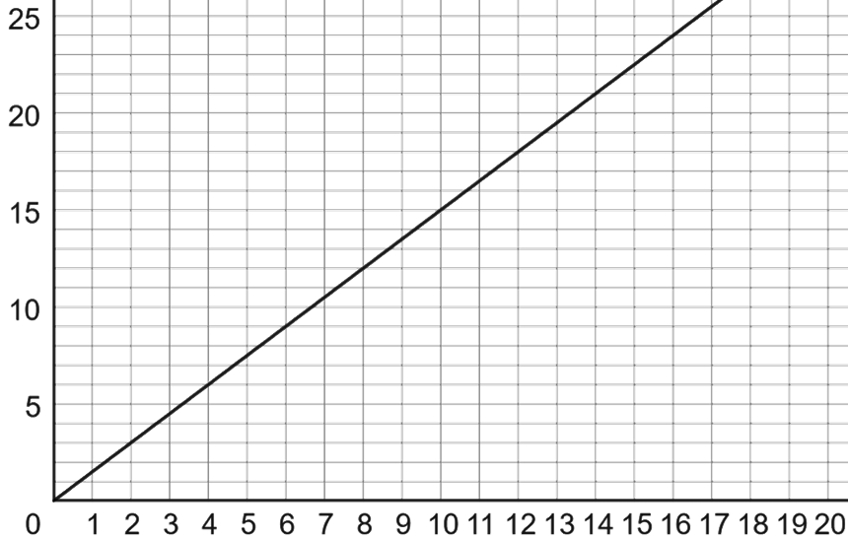
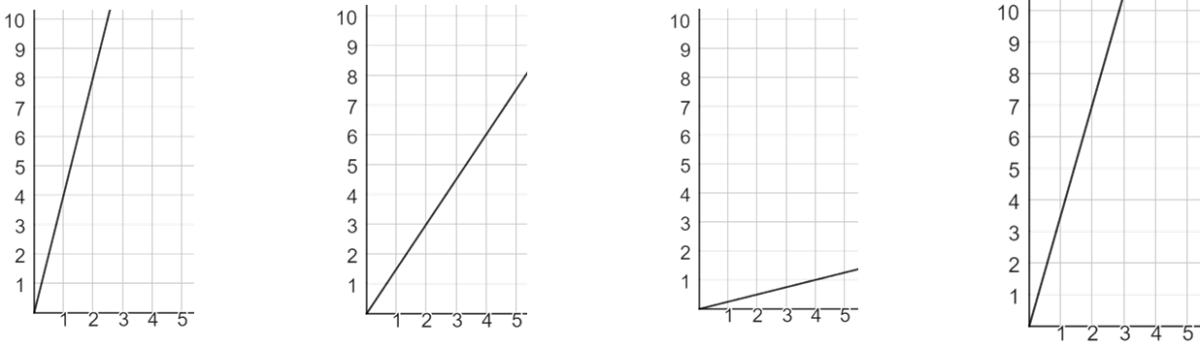
Multiplicative relationships and direct proportion
c)
1 | 1.5
2 | 3
4 | 6
8 | 12
3) Match each double number line to the correct graph:
y
A
y
B
y
C
y
D
x
x
x
x
2
4
x
1
4
x
0.5
4
x
2
5
x
D
y
C
y
B
y
A
y
7
14
0.25
1
0.75
6
8
20
Mathematics in Education and Industry
v2.3

